Slide 1
Secure data hiding in image using steganography
CAPSTONE PROJECT
Presented By: Ayushman Maurya
Student Name : Ayushman Maurya
College Name: Bundelkhand Institute of Engineering and Technology Jhansi
Department: Electronics and Communication Engineering

Slide 2
OUTLINE
Problem Statement
Technology used
Wow factor
End users
Result
Conclusion
Git-hub Link
Future scope

Slide 3
Problem Statement
Existing steganography tools often present a complex or technical interface, making them inaccessible to non-technical users. This project aims to develop a user-friendly steganography application that simplifies the process of embedding and extracting hidden data within images, while maintaining a high level of security. While steganography offers a means of hiding data within images, existing methods often lack sufficient security. Vulnerabilities can include susceptibility to steganalysis (detection of hidden data), weak or non-existent encryption of the embedded data, and reliance on easily guessable or weak passwords. This necessitates the development of steganographic techniques that provide strong security against detection and unauthorized access, ensuring the confidentiality and integrity of hidden information.

Slide 4
Technology used
System Requirements -
Operating Systems: The code should work on any operating system that supports Python and the required libraries.
Python Version should be older than 2.7 and it is recommended to use python3.
Libraries -
Tkinter: Standard Python library for creating graphical user interfaces (GUIs). It's usually included with Python installations.
cv2 (OpenCV): Used for image processing, specifically reading and writing images.
OS: Standard Python library for interacting with the operating system (e.g., getting the current directory).
PIL (Pillow): Used for image manipulation and working with various image formats, especially for displaying images in the Tkinter GUI.
Stegano: A library specifically for steganography. It provides the lsb.hide and lsb.reveal functions you're using.

Slide 5
Wow factors
Password Protection: The most significant feature is the inclusion of password protection. This is crucial for security. It ensures that only someone with the correct password can retrieve the hidden message, even if they have the steganographic image. This directly addresses a major vulnerability in basic steganography implementations.
Error Handling: The code includes basic error handling (using try...except blocks and messagebox warnings) to catch common issues like missing images or incorrect passwords. This makes the application more user-friendly and robust.
Image Format Support: The code supports multiple common image formats (PNG, JPG, JPEG) for both embedding and retrieving messages.
User-Friendly GUI: The use of Tkinter provides a graphical user interface (GUI), making the application accessible to users who may not be comfortable with command-line tools. The GUI simplifies the process of selecting images, entering messages, and saving the steganographic image.

Slide 6
End users
Individuals:
Privacy-conscious users: People who want to send messages or information discreetly, without it being obvious that they are doing so. This could be for personal or sensitive communication.
Journalists and whistleblowers: Those who need to communicate confidentially with sources or share sensitive information without fear of interception.
Activists and dissidents: Individuals in countries with restricted internet access or surveillance who need to communicate securely.
Organizations:
Businesses: For secure internal communication, sharing confidential documents, or protecting trade secrets.
Government agencies: For discreet communication and information sharing (though they likely have more sophisticated tools).
Law enforcement: For covert communication and evidence gathering (again, they may have specialized tools).

Slide 7
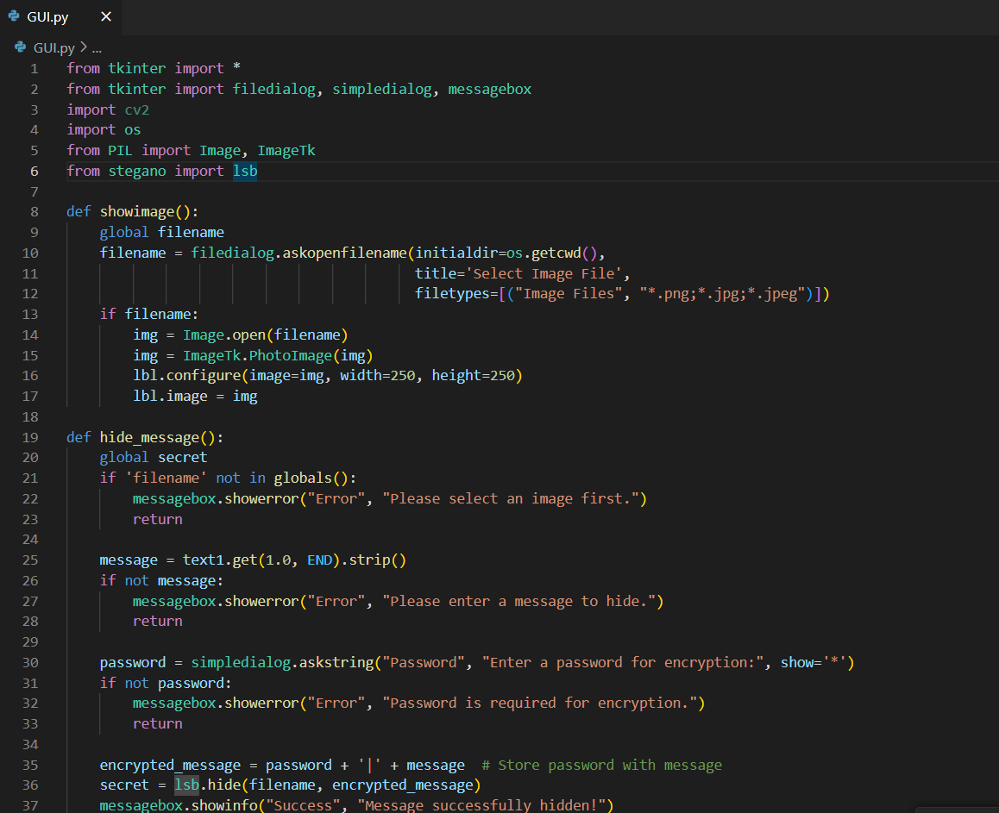
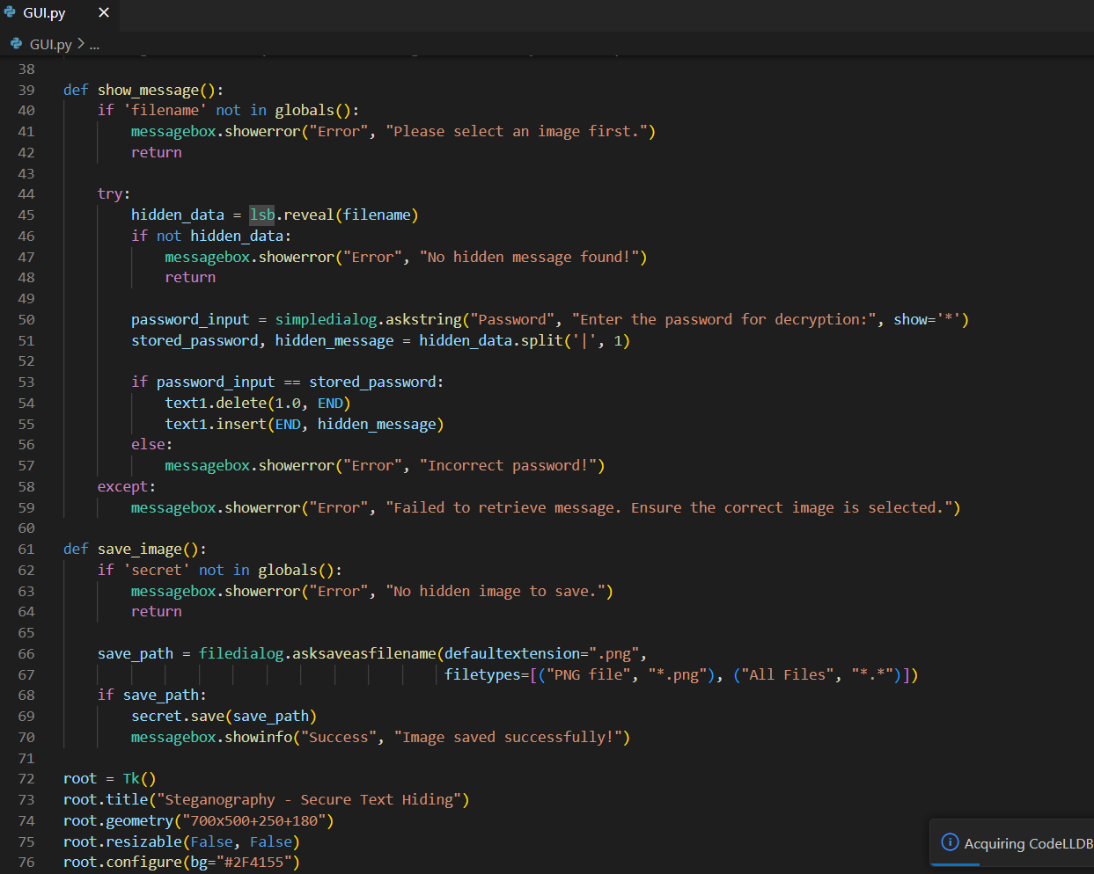
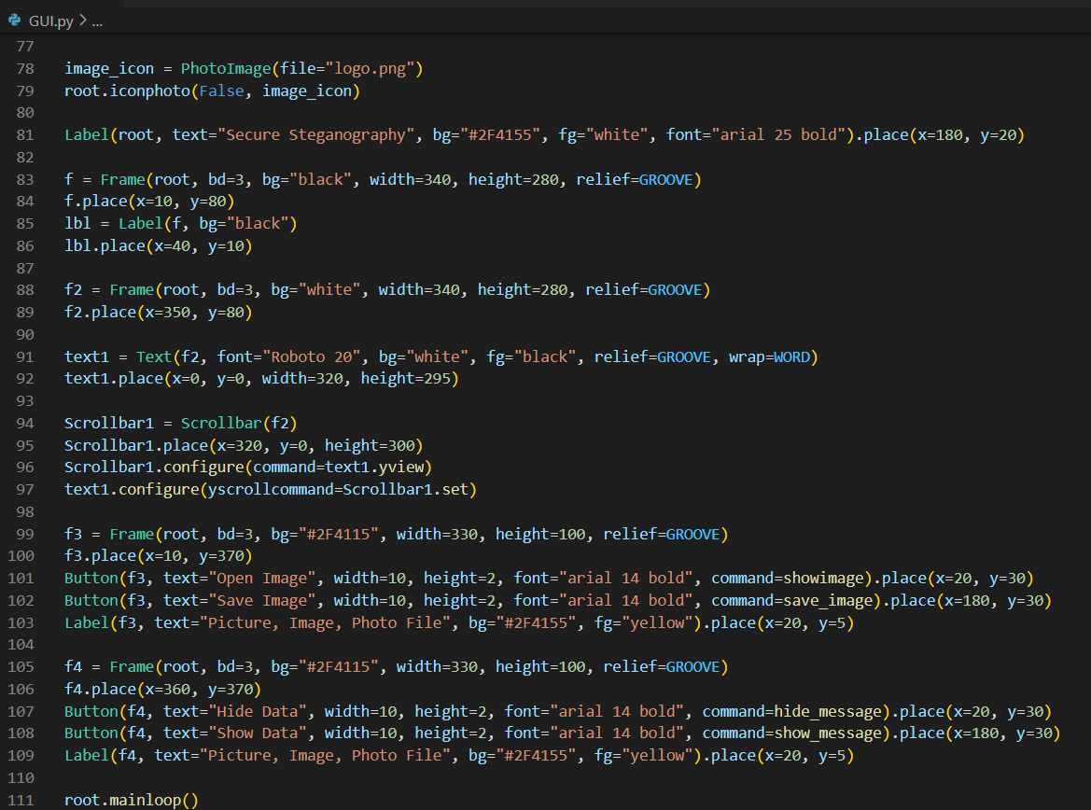
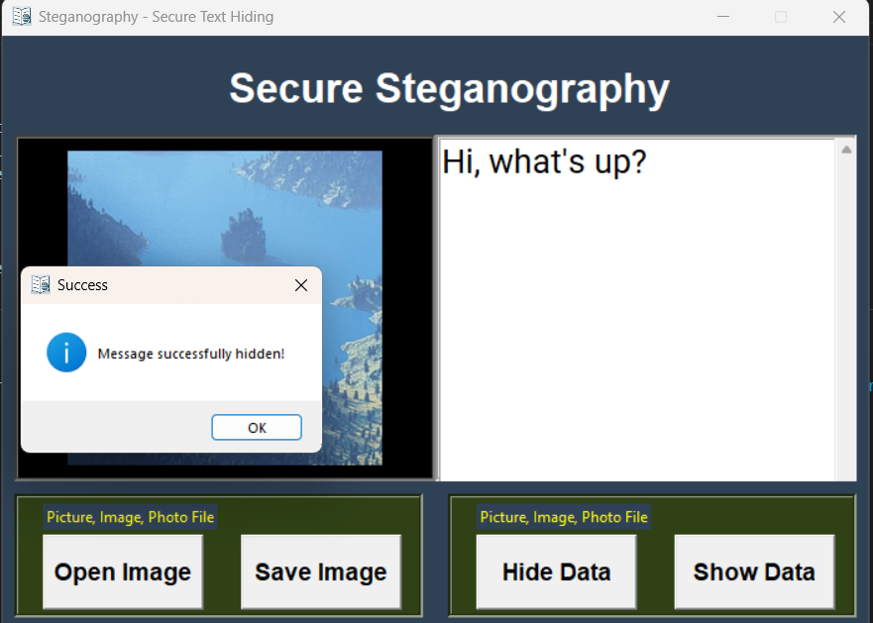
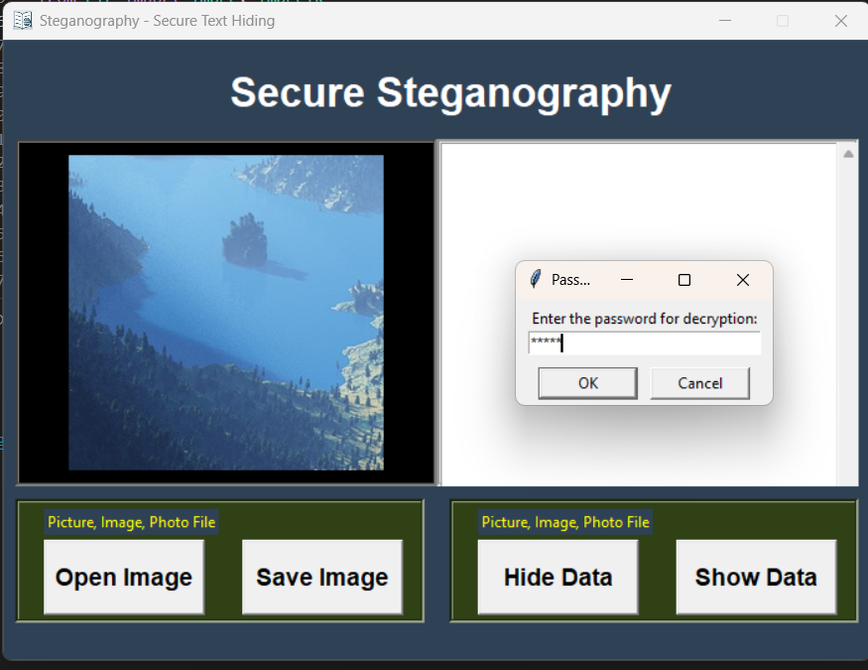
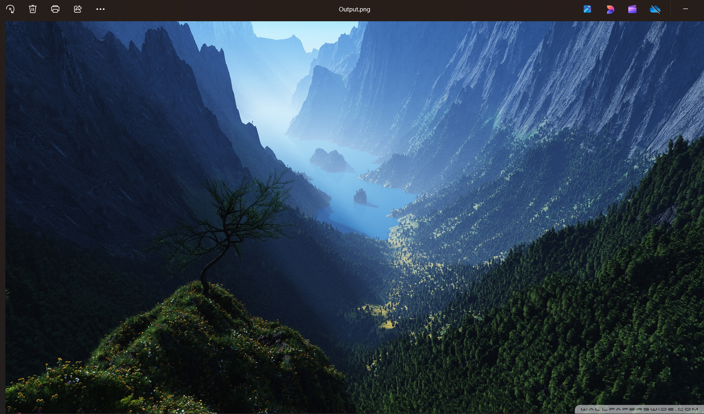
Results

Slide 8
Conclusion
This project successfully addressed the challenge of creating a user-friendly and secure steganography application. Recognizing that existing tools often present complex interfaces, hindering accessibility for non-technical users, this project prioritized simplicity and ease of use. A graphical user interface (GUI) was developed to streamline the process of embedding and extracting hidden data within images, making steganography accessible to a broader audience. Furthermore, acknowledging the security vulnerabilities prevalent in many current steganographic methods, this project incorporated robust security measures. Specifically, the implementation of password protection ensures that only authorized individuals with the correct password can access the hidden information, mitigating the risk of unauthorized disclosure. The project leveraged the Least Significant Bit (LSB) technique for data embedding, balancing capacity with imperceptibility. While the current implementation focuses on textual data and password-based security, future development could explore incorporating stronger encryption algorithms (such as AES) to further enhance confidentiality and integrating more advanced steganographic techniques to improve resistance against steganalysis. Additionally, expanding support for diverse data types beyond text and exploring methods to automatically assess image capacity to prevent data loss would be valuable extensions. Overall, this project provides a significant step towards democratizing access to secure steganography by combining user-friendliness with essential security features, thus empowering non-technical users to protect their sensitive information.

Slide 9
GitHub Link
https://github.com/Heller01/Secure-Data-Hiding-in-Images-Using-Steganography.git

Slide 10
Future scope(optional)
Security Enhancements:
Stronger Encryption: Integrate robust encryption algorithms like AES-256 to encrypt the hidden message before embedding it. This would provide an additional layer of security, even if the steganographic method is compromised.
Key Derivation Function (KDF): Implement a KDF (e.g., PBKDF2, bcrypt) to derive the encryption key from the user-provided password. This would make brute-force attacks significantly more difficult.
Functional Improvements:
Support for Diverse Data Types: Extend the application to support embedding various data types beyond text, such as images, audio files, or even other files.
Increased Capacity: Investigate methods to increase the data hiding capacity without compromising imperceptibility. This could involve exploring different steganographic algorithms or optimizing the use of the LSB method.

Slide 11
THANK YOU

